Slide 1
Front-End Web Development
Module 2.5 - Bootstrap

Slide 2
Presentation Contents
What is Bootstrap?
Linking Bootstrap CSS into HTML and JavaScript
Using Bootstrap classes

Slide 3
Course objectives
Describe what Bootstrap is used for
Explore how Bootstrap is linked to HTML files
Apply Bootstrap classes to HTML elements

Slide 4
What is Bootstrap?
Bootstrap is a very popular and widely used responsive framework.
When we call something responsive what we mean is that the page will adapt based on the device used to view that page.
Bootstrap is a collection of CSS and JavaScript which we link into our HTML and leverage with classes and id’s.
If HTML is the chair, CSS is the material we are using to cover the chair then JavaScript turns that chair into a rotating chair.
Bootstrap is like buying a chair that’s been covered and made into a folding chair for us already.

Slide 5
Linking Bootstrap CSS into our HTML
We link the bootstrap CSS in the same way we link our own CSS.
We can link multiple CSS files into a single HTML file.
We want our CSS to be the last stylesheet linked so that we can override bootstraps CSS not the other way around.
We also need the viewport to improve rendering and touch zooming.
<head> <meta name="viewport" content="width=device-width, initial-scale=1"> <link href="css/bootstrap.min.css" rel="stylesheet" media="screen"> <link href="css/main.css" rel="stylesheet" media="screen"> </head>

Slide 6
Linking Bootstrap JavaScript
For bootstrap to work properly we need to link in the JavaScript for both bootstrap and Jquery.
JQuery is a JavaScript library that focuses on adding animation and transitions to websites.
You can also see here how you can link JavaScript using both URL’s and JavaScript files packaged with the HTML.
<body></body> <script src="https://ajax.googleapis. com/ajax/libs/jquery/1.12.4/jquery.min.js"></script> <script src="js/bootstrap.min.js" type="text/javascript"></script> </html>

Slide 7
Making a Bootstrap navbar
We will be using the same code from the HTML example.
Here we are applying rules to our nav and div tags to move them to the top of the screen.
Each class will apply a couple of rules to manipulate the pages Structure.
navbar-fixed-top for example only sets the element to move with the user when scrolling
<nav class="navbar navbar-fixed-top navbar-inverse"> <div class="container"> <div class="navbar-header">

Slide 8
Practice activities
Create a button in HTML, visit “getbootstrap.com”, copy the appropriate tag into your HTML code and apply bootstrap to the button using bootstrap CSS classes.
Discover how to apply bootstrap to HTML elements.

Slide 9
Solution
<head> … <link rel="stylesheet" href="https://stackpath.bootstrapcdn.com/bootstrap/4.3.1/css/bootstrap.min.css" integrity="sha384-ggOyR0iXCbMQv3Xipma34MD+dH/1fQ784/j6cY/iJTQUOhcWr7x9JvoRxT2MZw1T" crossorigin="anonymous">
… </head>
<button class=“btn btn-primary" Click</button>

Slide 10
Burger Button
When the screen gets too small to display our navigation links we want them to collapse into an expandable menu.
We can use this bit of code to render that button when this happens.
The data-target is used by JavaScript to take any element within the specified id into the dropdown.
</a> <button data-toggle="collapse" class="navbar-toggle collapsed" data-target="#navbar" type="button" aria-expanded="false" aria-controls="navbar"> <span class="sr-only"> Toggle Navigation </span> <span class="icon-bar"></span> <span class="icon-bar"></span> <span class="icon-bar"></span> </button>

Slide 11
Making our Menu Collapsible
We want our menu links to be included in the dropdown so we will give the containing <div> the id of navbar.
We will also use the class of navbar-right to float the elements to the right of the navbar.
All of the classes we are applying we can override in our own CSS files.
<div id="navbar" class="collapse navbar-collapse"> <div class="navbar-right"> <!-- Page Links --> <ul class="nav navbar-nav"> <li class="navbar-brand"> <a href="manage_stock.html"> Manage Stock</a></li> <li class="navbar-brand"> <a href="replenish_stock.html"> Replenish Stock</a></li> </ul>

Slide 12
Navbar Form
We will be applying styles to our navbar form as well.
The btn class will style the button to look more “buttony”.
btn-success will make the button visually distinctive to other buttons.
</ul> <form class="navbar-form navbar-right"> <button class="btn btn-success"> Exit </button> </form> </div>

Slide 13
Bootstrap Columns
Here we are specifying how many columns we want each section to take up.
We can change the number of columns based on the size of screen.
The sizes are lg, md, sm and xs.
We must have a div with the class of container wrapping any column classes
<div class="mainContent"> <!-- Main Content --> <section id="stockListSection" class="col-md-3 col-sm-4"> <!-- stock list --> </section> <section class="col-md-9 col-sm-8"> <!-- Product detail view --> </section>

Slide 14
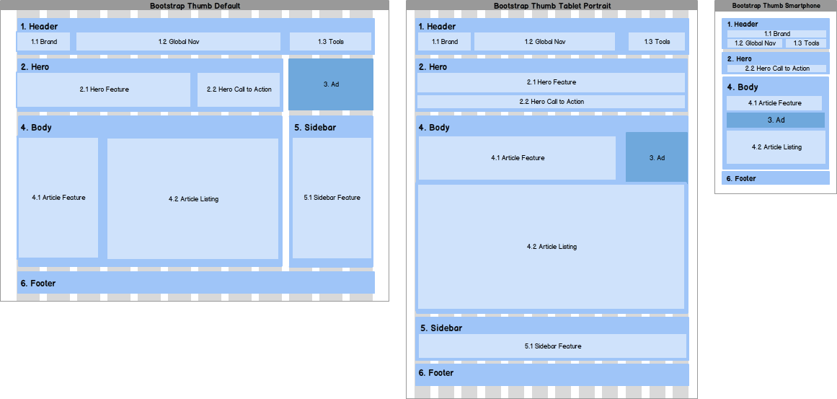
BOOTSTRAP GRIDS
Here we can see an example of bootstraps grid system.
As the screen narrows the elements on the page rearrange.
This allows for a better mobile experience.

Slide 15
Bootstrap Examples
https://blackrockdigital.github.io/startbootstrap-freelancer/
https://startbootstrap.com/

Slide 16
Government Template
https://www.gov.uk/service-manual/design/using-the-govuk-template-frontend-toolkit-and-elements
Government templates have to conform to very particular standards
Use specific Font colours, sizes, positioning of elements

Slide 17
Course Objectives – Summary
Describe what Bootstrap is used for
We can make use of the Bootstrap framework which provides templates of CSS for HTML elements
Explore how Bootstrap is linked to HTML files and apply Bootstrap classes to HTML elements
We can link Bootstrap templates into the <Head/> tag of a HTML file as we do with CSS files
Apply Bootstrap classes to HTML elements
Bootstrap class names can be used in “class” attribute of HTML element tags to apply Bootstrap classes

Slide 18
Thank you for listening.
Any questions?

